Slide 1


Slide 2
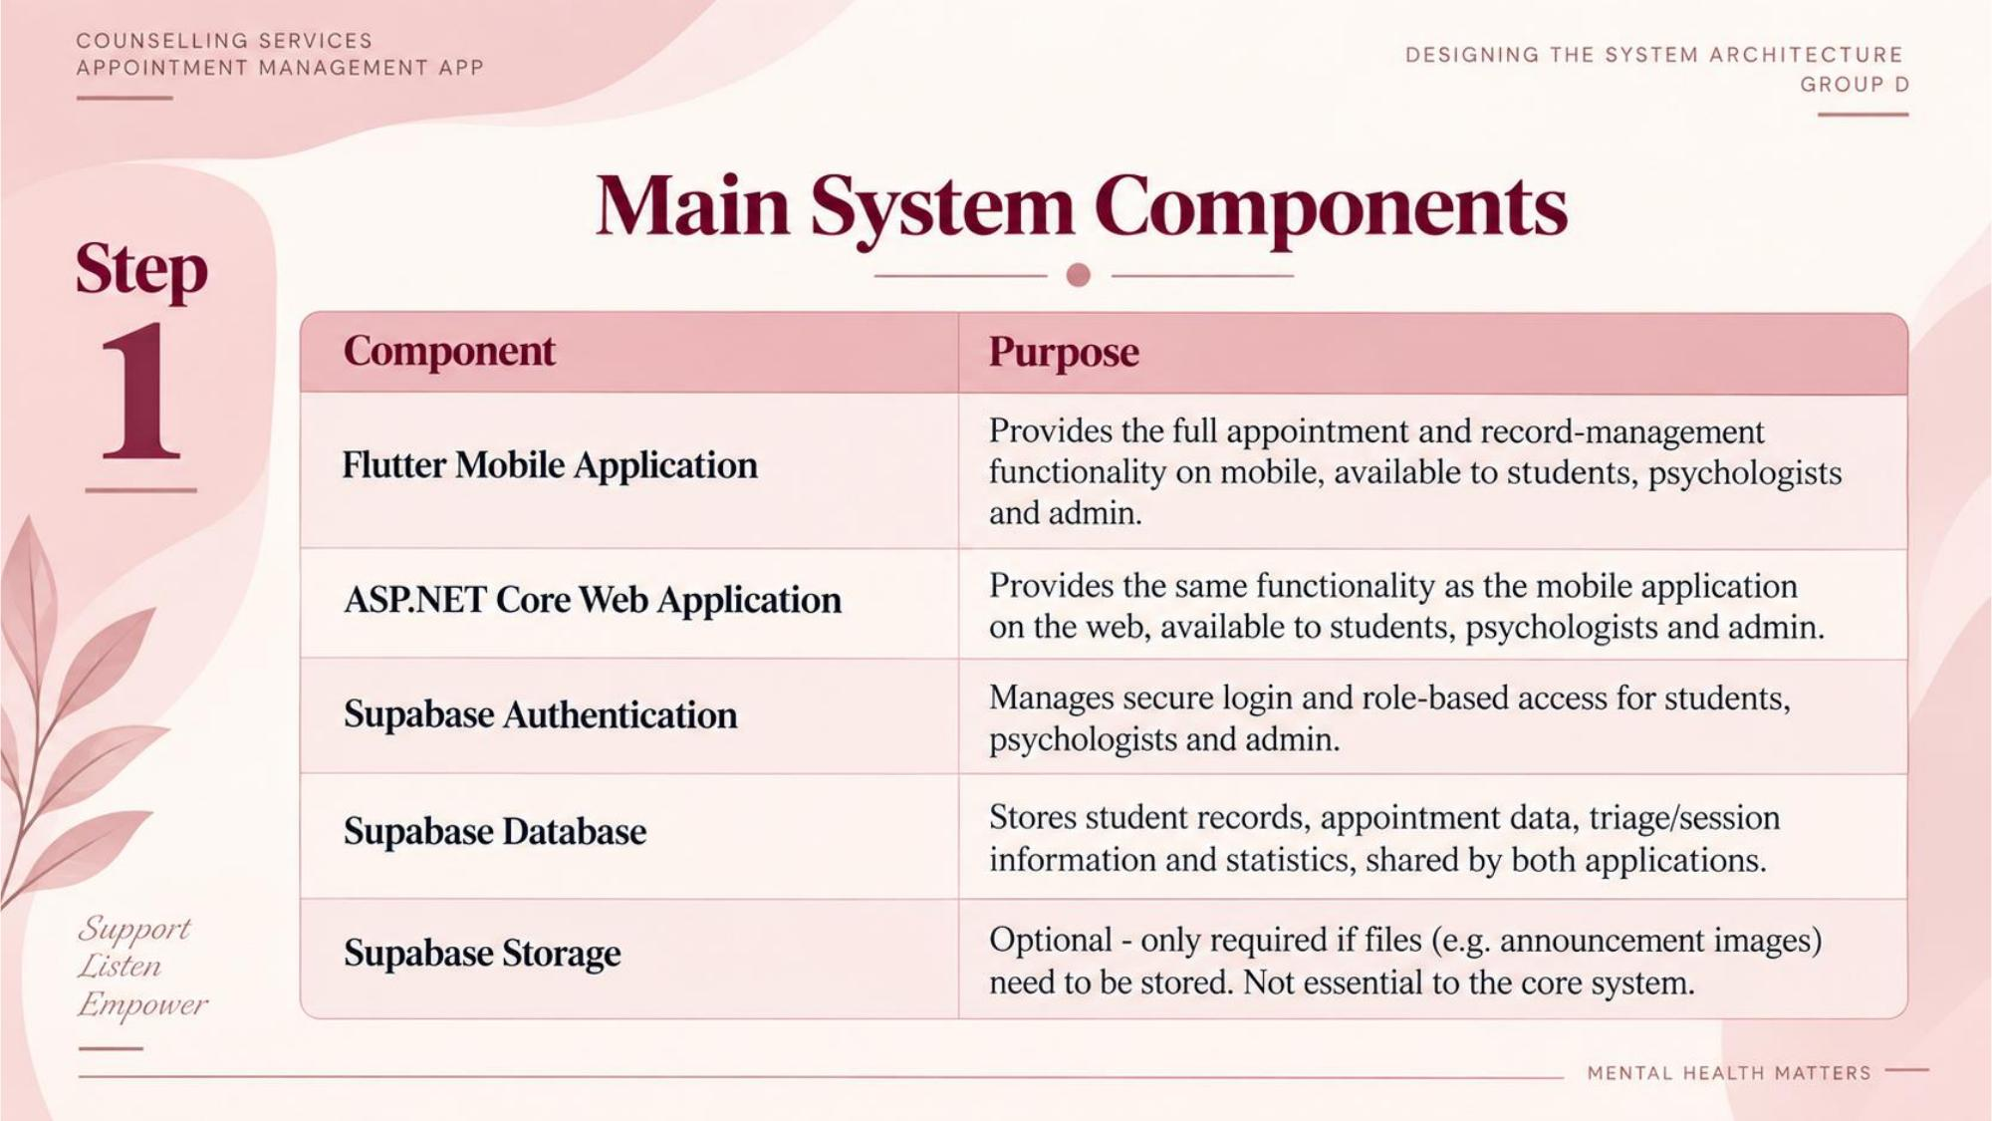

Slide 3
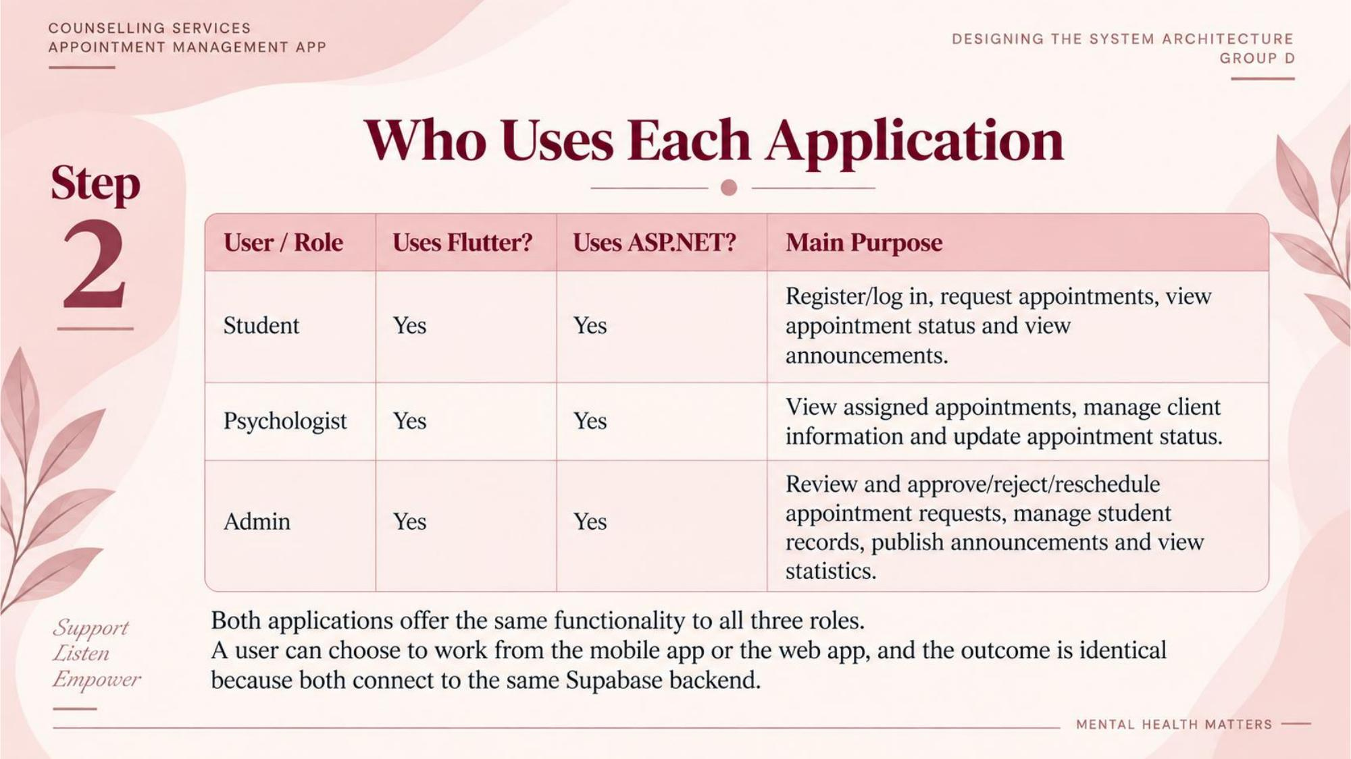

Slide 4
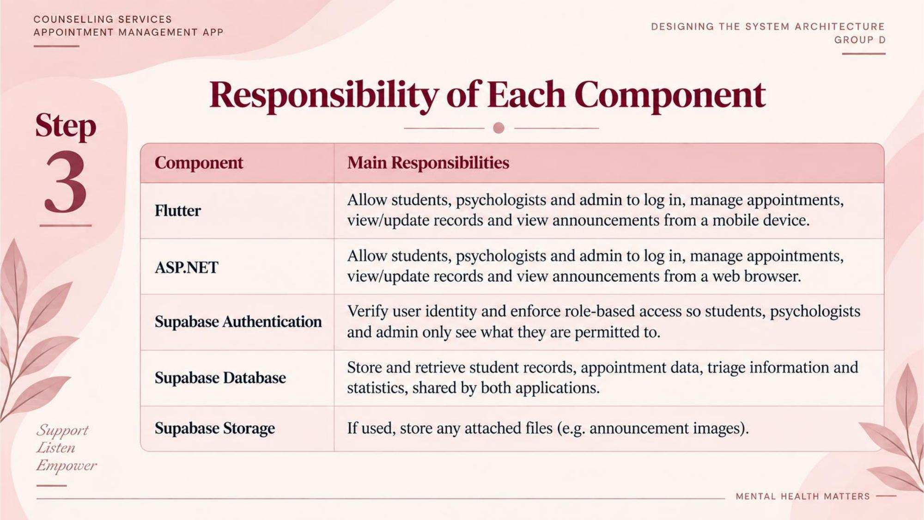

Slide 5
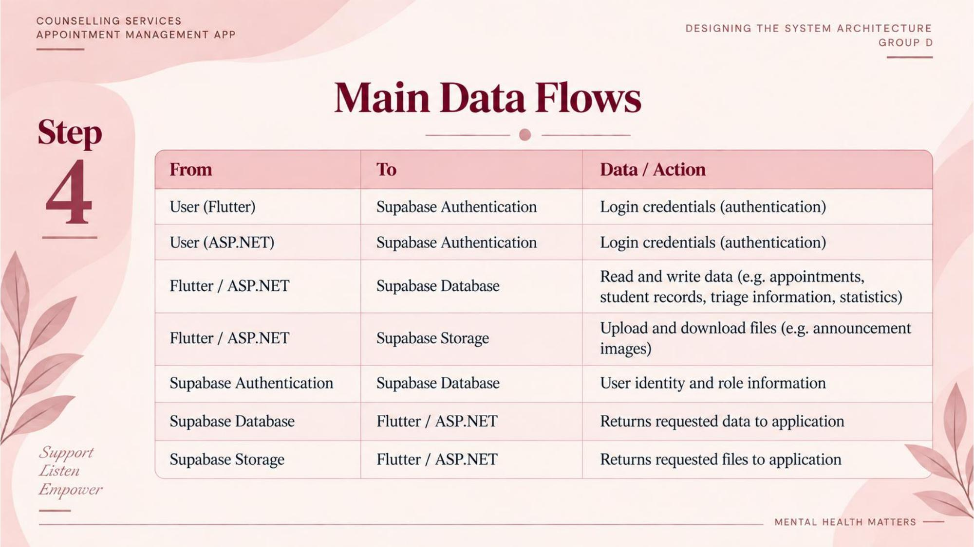

Slide 6
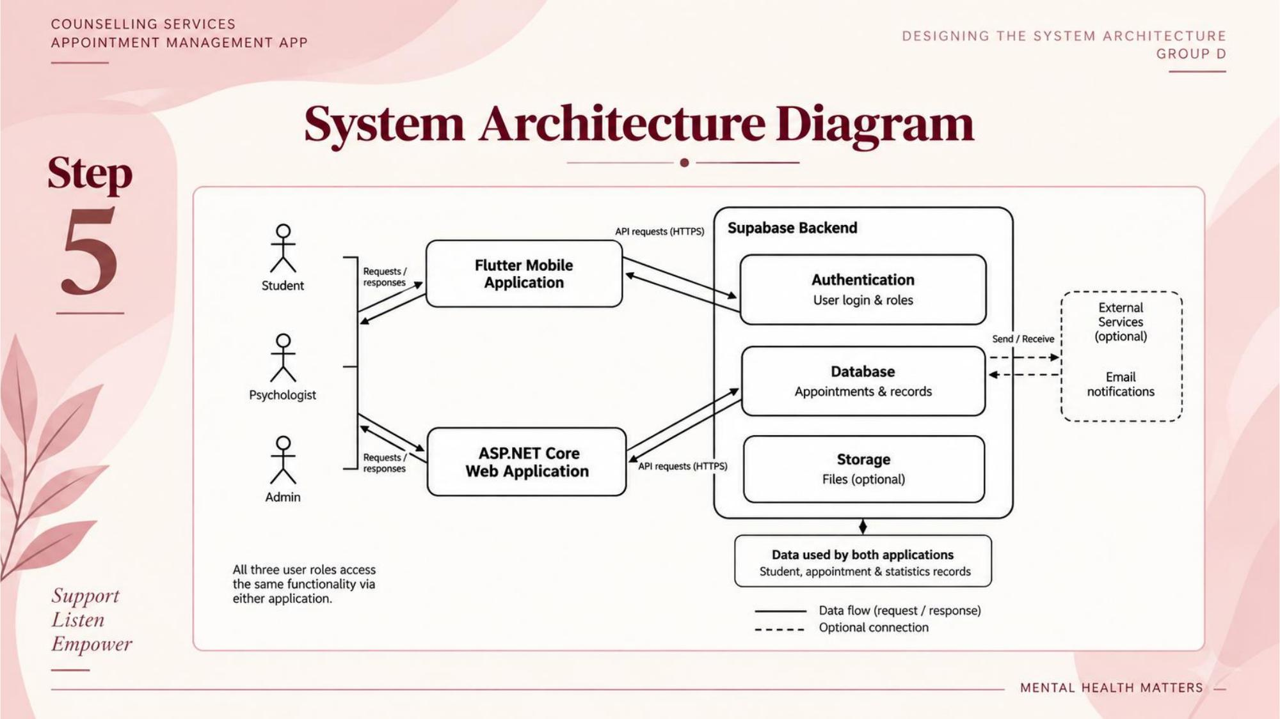

Slide 7
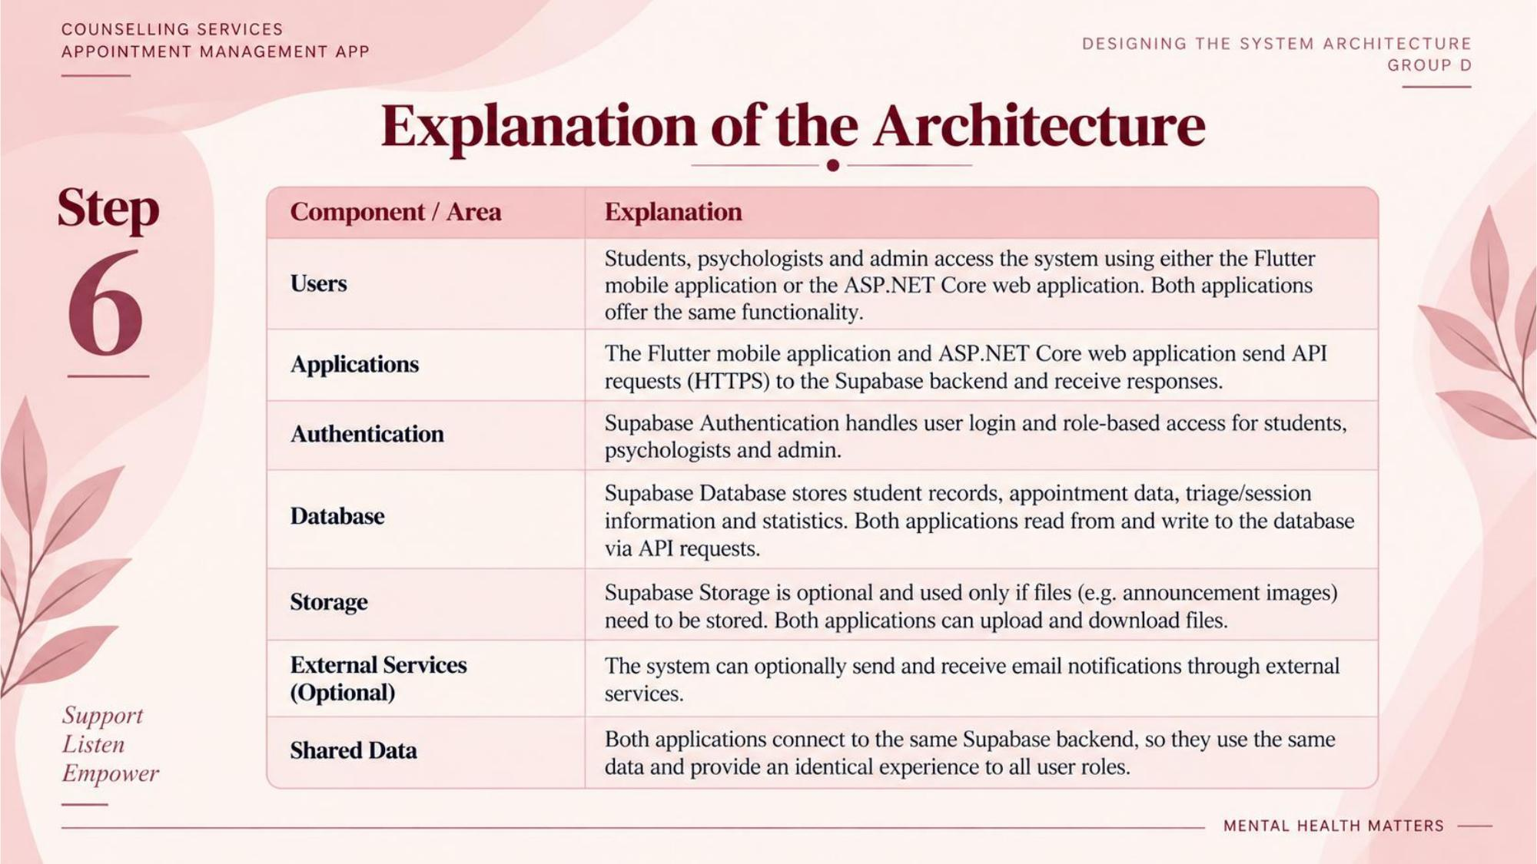

Slide 8
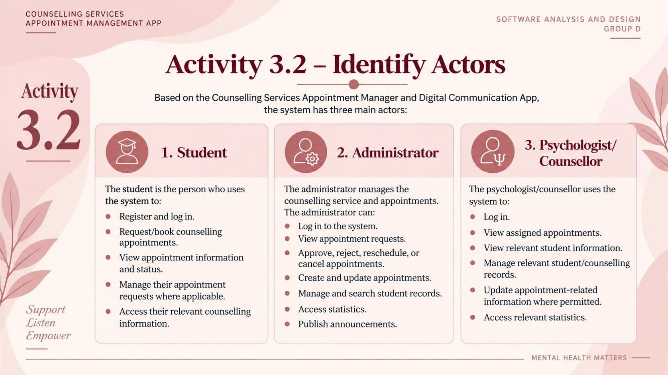

Slide 9
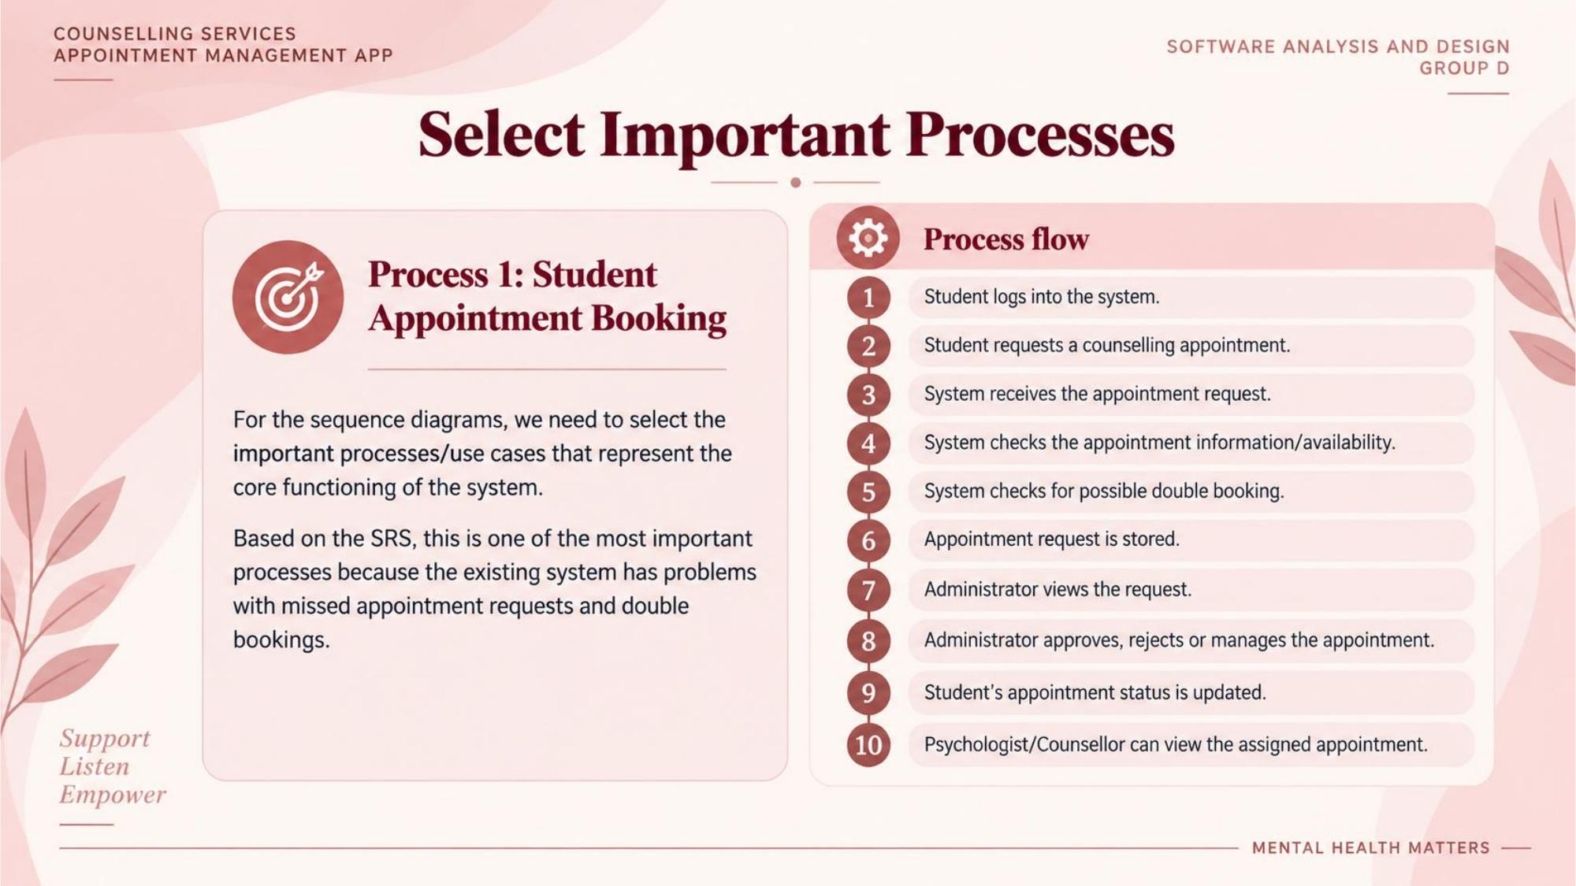

Slide 10
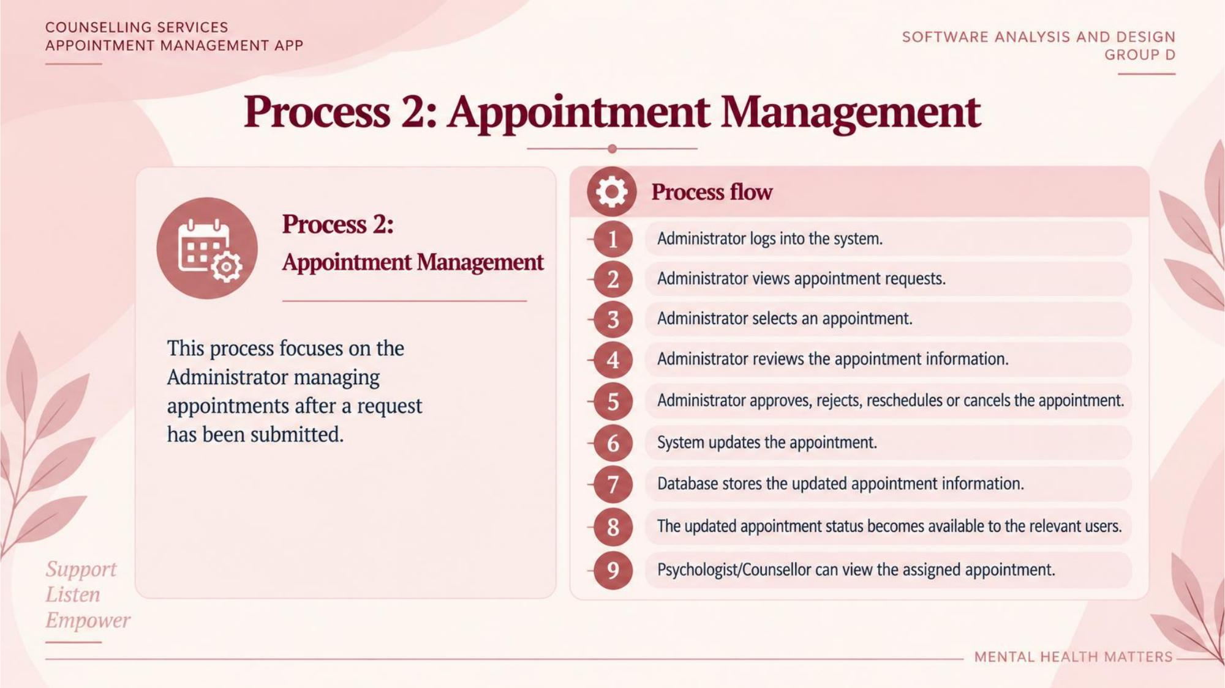

Slide 11
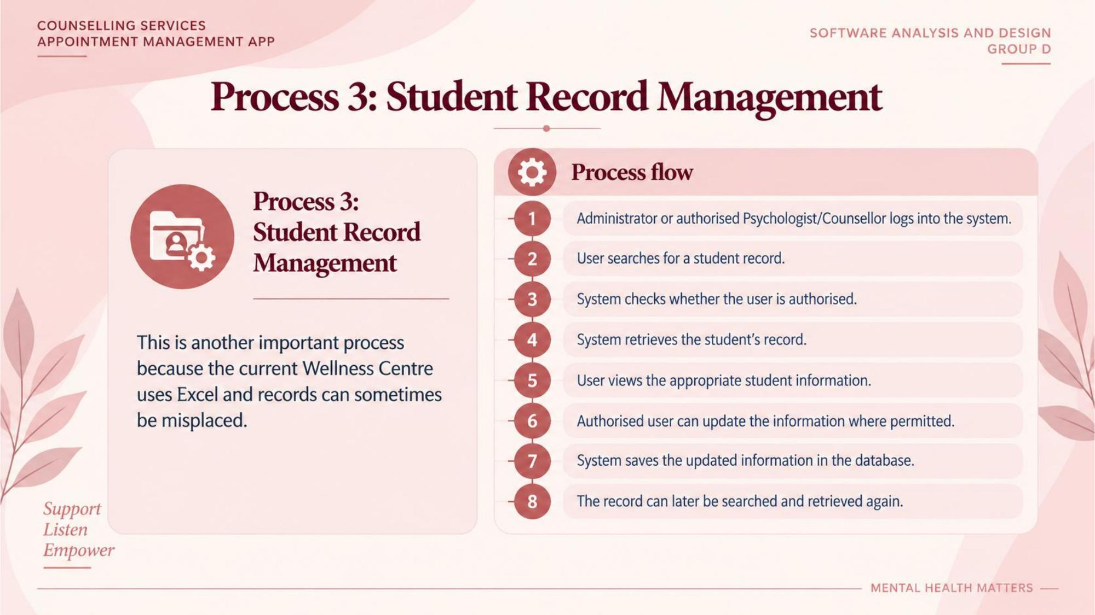

Slide 12
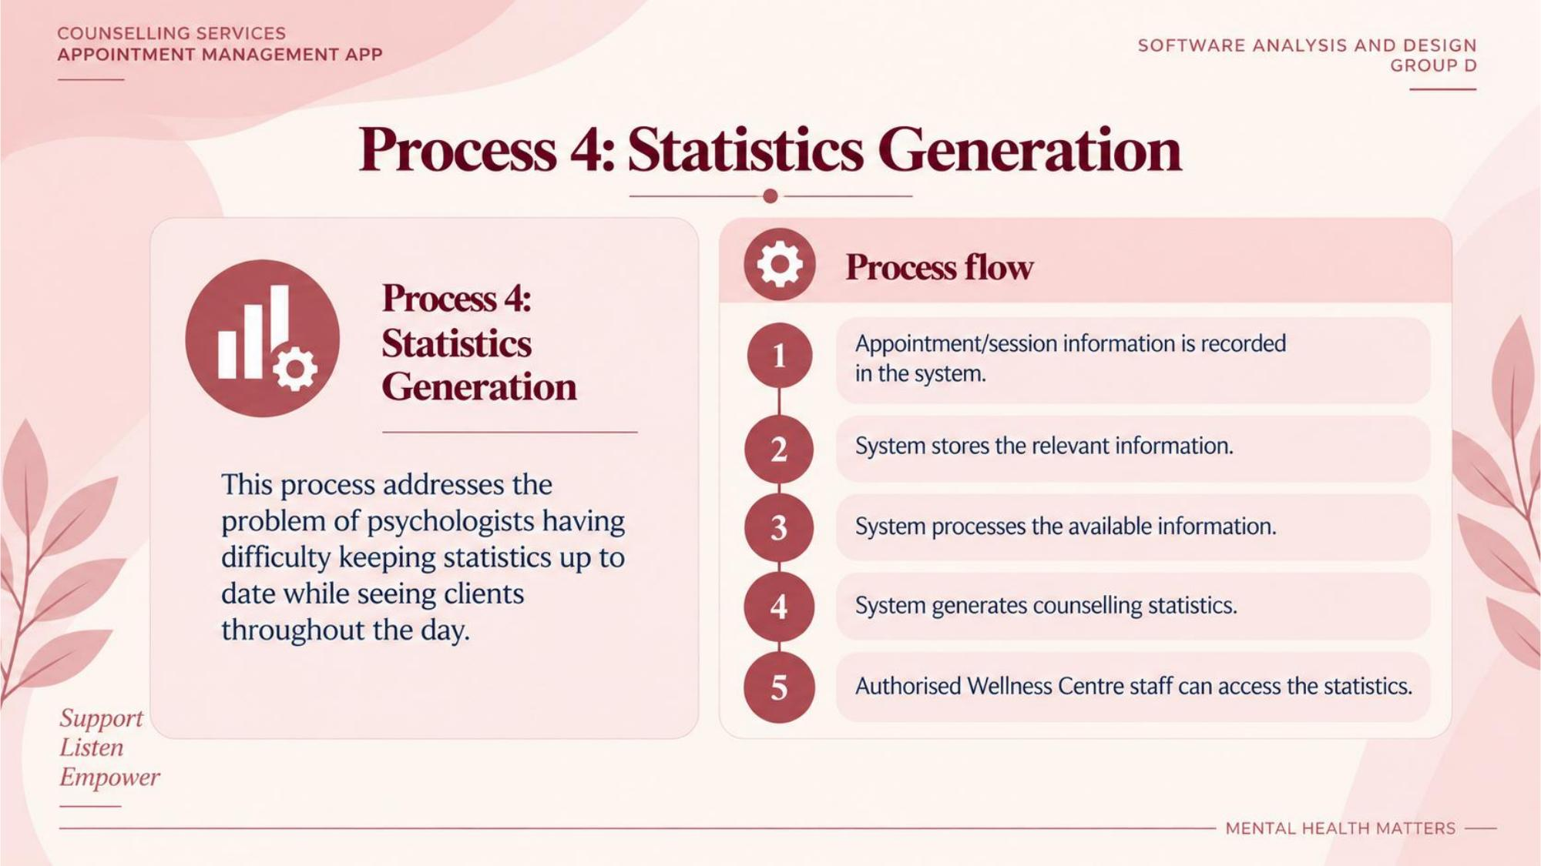

Slide 13
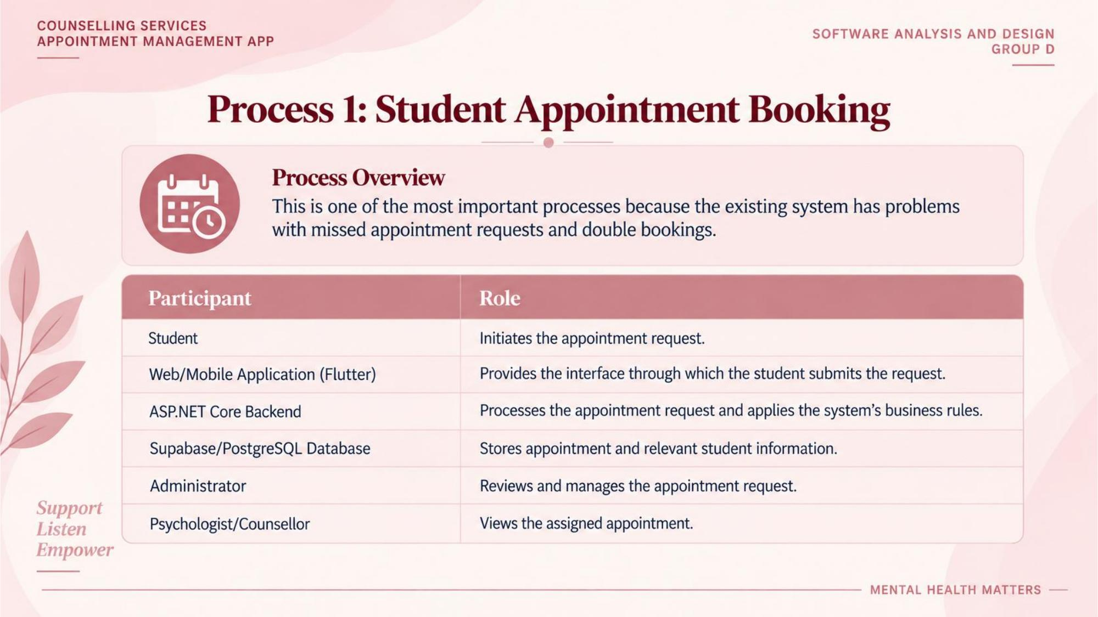

Slide 14
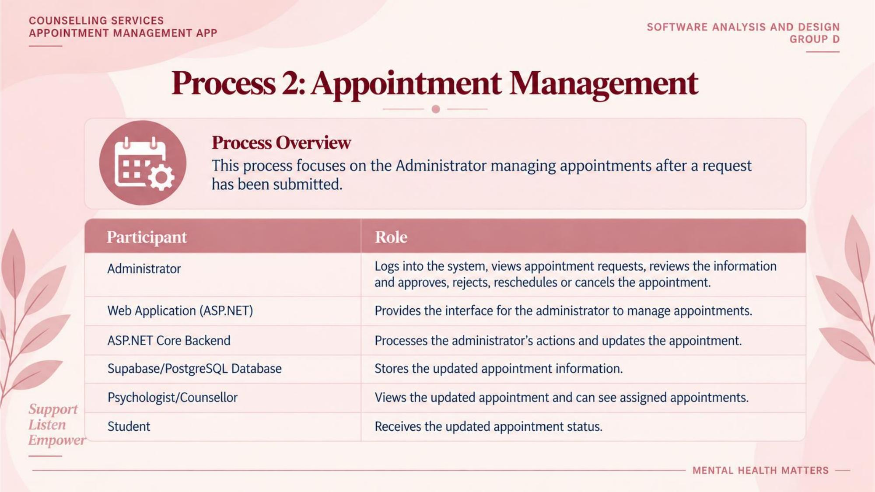

Slide 15
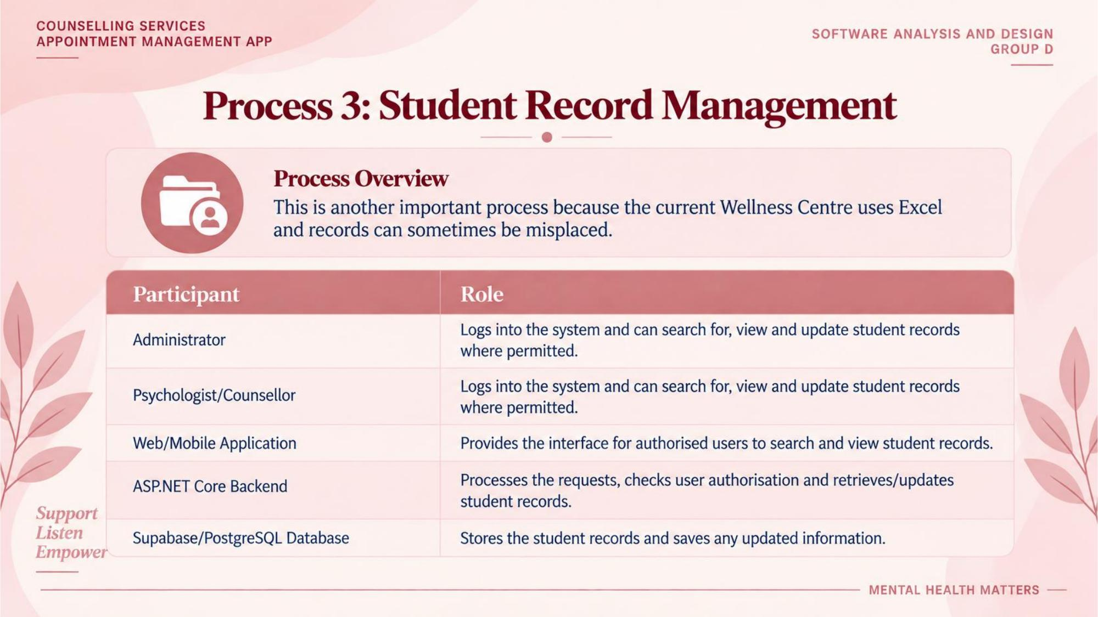

Slide 16
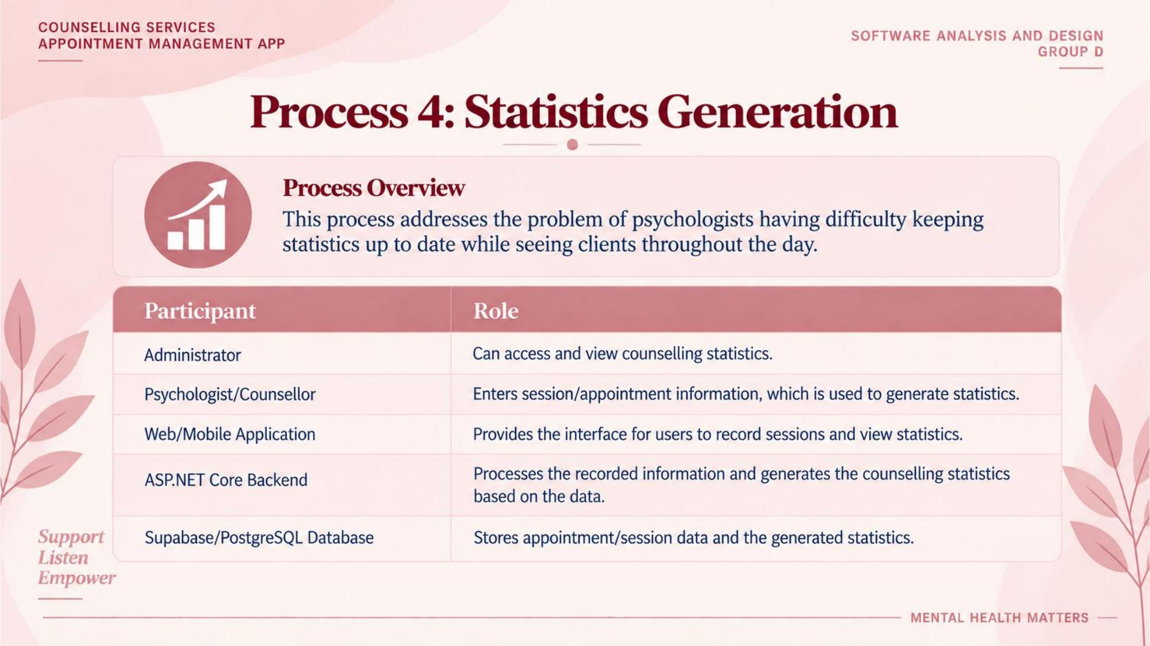

Slide 17
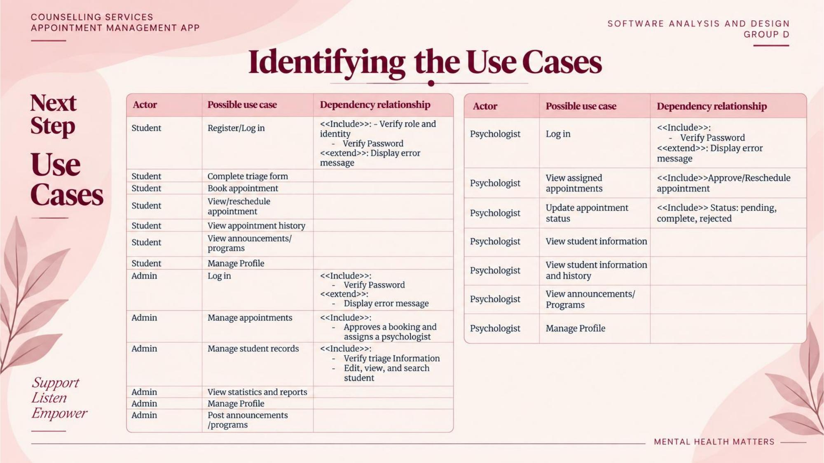

Slide 18
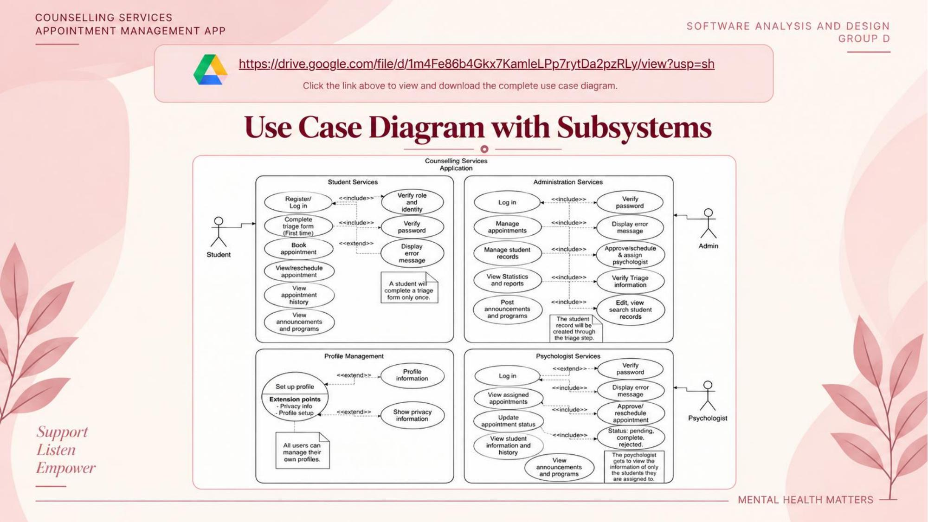

Slide 19
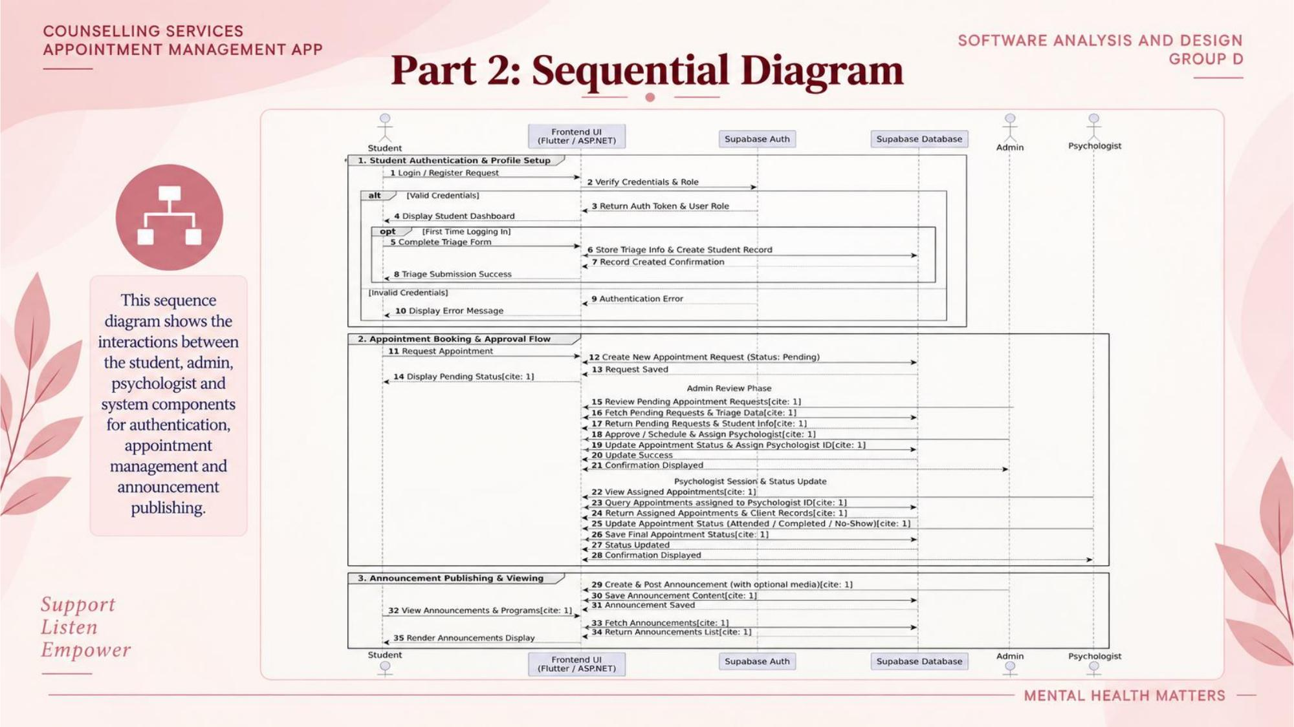

Slide 20
AnCora Activity 3.3
User Interface Design · Navigation · Integration · ERD Alignment
Compiled after the System Architecture, Use Cases & Sequence Diagrams

Slide 21
ANCORA · ACTIVITY 3.3
STEP 2 — REQUIRED FLUTTER SCREENS
Step 2 — Required Flutter Screens (Student)
Flutter Screen
Purpose
Related Requirement / Use Case
Login
Securely logs the student into the system
Student Login
Student Dashboard
Access to main counselling services
View Dashboard
Request Appointment
Triage information and appointment request
Request Appointment
My Appointments
View upcoming appointments and status
View / Manage Appointments
Appointment History
View previous appointments
View Appointment History
Messages & Announcements
View messages and announcements
View Messages & Announcements
Profile
View or manage profile information
Manage Profile
Support · Listen · Empower
MENTAL HEALTH MATTERS

Slide 22
ANCORA · ACTIVITY 3.3
STEP 2 — REQUIRED ASP.NET SCREENS
Step 2 — Required ASP.NET Screens (Student)
ASP.NET provides the same student screens as Flutter. Both apps share the identical feature set and connect to the same Supabase backend.
ASP.NET Screen
Purpose
Related Requirement / Use Case
Login
Securely logs the student into the system
Student Login
Student Dashboard
Access to main counselling services
View Dashboard
Request Appointment
Triage information and appointment request
Request Appointment
My Appointments
View upcoming appointments and status
View / Manage Appointments
Appointment History
View previous appointments
View Appointment History
Messages & Announcements
View messages and announcements
View Messages & Announcements
Profile
View or manage profile information
Manage Profile
Support · Listen · Empower
MENTAL HEALTH MATTERS

Slide 23
ANCORA · ACTIVITY 3.3
STEP 2 — REQUIRED ASP.NET SCREENS
Step 2 — Required ASP.NET Screens (Psychologist & Admin)
Psychologist Screens
Administrator Screens
Login
Secure login for psychologist
Login
Secure login for administrator
Psychologist Dashboard
Today’s appointments & pending requests
Administrator Dashboard
Overview: students, appointments, stats
Manage Appointments
View, confirm or decline appointments
Manage Students
Search, view and update student records
Manage Appointments
Approve, reject, reschedule or cancel
Appointment Details
Triage info, notes, status updates
Appointment Details
Full appointment and triage information
Student Records
View relevant student information
Reports & Statistics
Counselling statistics and reports
Messages & Announcements
Messages and centre announcements
Messages & Announcements
Create and publish announcements
Profile
View or manage profile information
Settings
User / account settings
Support · Listen · Empower
MENTAL HEALTH MATTERS

Slide 24
ANCORA · ACTIVITY 3.3
STEP 5 — NAVIGATION BETWEEN SCREENS
Student Navigation Map
Starting Screen
User Action
Next Screen
Login
Enter credentials and log in
Student Dashboard
Student Dashboard
Select Request Appointment
Request Appointment
Request Appointment
Enter triage information
Select Date & Time
Select Date & Time
Select available appointment
Confirm Appointment
Confirm Appointment
Submit request
My Appointments
Student Dashboard
Select My Appointments
My Appointments
My Appointments
Select an appointment
Appointment Details
Student Dashboard
Select Appointment History
Appointment History
Student Dashboard
Select Messages & Announcements
Messages & Announcements
Student Dashboard
Select Profile
Profile
Any authenticated screen
Select Log Out
Login
Support · Listen · Empower
MENTAL HEALTH MATTERS

Slide 25
ANCORA · ACTIVITY 3.3
STEP 5 — NAVIGATION BETWEEN SCREENS
Psychologist & Administrator Navigation
Psychologist Navigation
Administrator Navigation
Login
→ Psychologist Dashboard
Login
→ Administrator Dashboard
Dashboard
→ Manage Appointments
Dashboard
→ Manage Students
Manage Appointments
→ Appointment Details
Dashboard
→ Manage Appointments
Appointment Details
→ Student Records
Manage Appointments
→ Appointment Details
Dashboard
→ Student Records
Dashboard
→ Reports & Statistics
Dashboard
→ Messages & Announcements
Dashboard
→ Messages & Announcements
Dashboard
→ Profile
Dashboard
→ Settings
Any screen
→ Log Out → Login
Any screen
→ Log Out → Login
Support · Listen · Empower
MENTAL HEALTH MATTERS

Slide 26
ANCORA · ACTIVITY 3.3
STEP 6 — MOBILE AND WEB INTEGRATION
Flutter ↔ Supabase ↔ ASP.NET Integration
Both applications use the same Supabase backend so information created or changed in one is immediately available to the other.
Flutter
Mobile App
→
Supabase
Database
→
ASP.NET
Web App
Flutter / Mobile Action
Supabase Data
ASP.NET Web Action
Student submits appointment (Flutter)
Creates Appointment
Psych / Admin views request (ASP.NET)
Student selects date / time
Stores Date & Time
Staff can view selected slot
Psychologist confirms / declines
Updates Status
Student sees updated status
Student information submitted
Stores Student info
Admin / Psych views record
Admin creates announcement
Creates Announcement
Available to all users
Support · Listen · Empower
MENTAL HEALTH MATTERS

Slide 27
ANCORA · ACTIVITY 3.3
STEP 6 — EXAMPLE INTEGRATION PROCESS
End-to-End Appointment Request Flow
1
2
3
4
Student logs in
Completes triage
Request stored
Staff views request
via Flutter mobile app
and requests appointment
in Supabase Database
through ASP.NET web app
5
6
7
Confirm or decline
Status updated
Student sees update
Psych / Admin updates status
in Supabase
opens mobile app
Support · Listen · Empower
MENTAL HEALTH MATTERS

Slide 28
ANCORA · ACTIVITY 3.3
STEP 7 — INTERFACE TO ERD ALIGNMENT
Student Interface ↔ ERD Alignment
Interface
Information / Function
ERD Entity
Attribute / Field
Login
Email / Password
USER
Email, Password
Dashboard
Student name
USER
FirstName, LastName
Request Appointment
Reason, Mood, Info
TRIAGE_RECORD
Reason, Mood, AdditionalInfo
Request Appointment
Date & Time
APPOINTMENT
AppointmentDate, Time
My Appointments
Date, Time, Psych, Status
APPOINTMENT
Date, Time, PsychologistID, Status
Appointment History
Previous appointments
APPOINTMENT
AppointmentID, Status
Messages
Sender, Recipient, Content
MESSAGE
SenderID, ReceiverID, MessageText
Announcements
Title & Content
ANNOUNCEMENT
Title, Content
Profile
Student information
STUDENT / USER
Student details
Support · Listen · Empower
MENTAL HEALTH MATTERS

Slide 29
ANCORA · ACTIVITY 3.3
STEP 7 — INTERFACE TO ERD ALIGNMENT
Psychologist & Administrator Interface ↔ ERD
Psychologist Interface
Administrator Interface
▸ Login → USER (Email)
▸ Login → USER (Email)
▸ Dashboard → APPOINTMENT (Date, Status)
▸ Dashboard → STUDENT, APPOINTMENT, ANNOUNCEMENT
▸ Dashboard → STUDENT (StudentID)
▸ Manage Students → STUDENT / USER
▸ Manage Appointments → APPOINTMENT
▸ Manage Appointments → APPOINTMENT
▸ Student Records → STUDENT / USER
▸ Reports & Statistics → APPOINTMENT counts
▸ Appointment Details → TRIAGE + APPOINTMENT
▸ Messages → MESSAGE
▸ Messages → MESSAGE
▸ Announcements → ANNOUNCEMENT (create)
▸ Announcements → ANNOUNCEMENT
▸ Settings → USER (account info)
Support · Listen · Empower
MENTAL HEALTH MATTERS

Slide 30
ANCORA · ACTIVITY 3.3
OVERALL DESIGN ALIGNMENT
How the Design Artefacts Align
SRS
Approved functional and non-functional requirements
Use Case Diagram
Shows which actor performs each system function
User Interface Design
Screens through which users perform the functions
ERD
Entities, relationships and fields that store interface data
Supabase
Stores the shared application data for both clients
Flutter Mobile App
Student-facing application using the shared data
ASP.NET Web App
Web application for all roles using the shared data
Support · Listen · Empower
MENTAL HEALTH MATTERS

Slide 31
Thank You
Group D · ITC327W · September 2026
Designing the System Architecture + AnCora Activity 3.3
(UI Design, Navigation, Integration & ERD Alignment)
Support · Listen · Empower · Mental Health Matters

